Slide 1
Aft -723 Minor Project -2 J.B. MANIK 12300623

Slide 2

agenda
Introduction
Idea - 1
Idea - 2
Idea - 3

Slide 3
What I choose is
Level Design

Slide 4
IDEA 1 – Galaxy shooter GG ( 3d unity game )
Survive the waves of enemies throughout the space , collect power-ups, and defeat enemies and a mini-boss to clear the level.

Slide 5
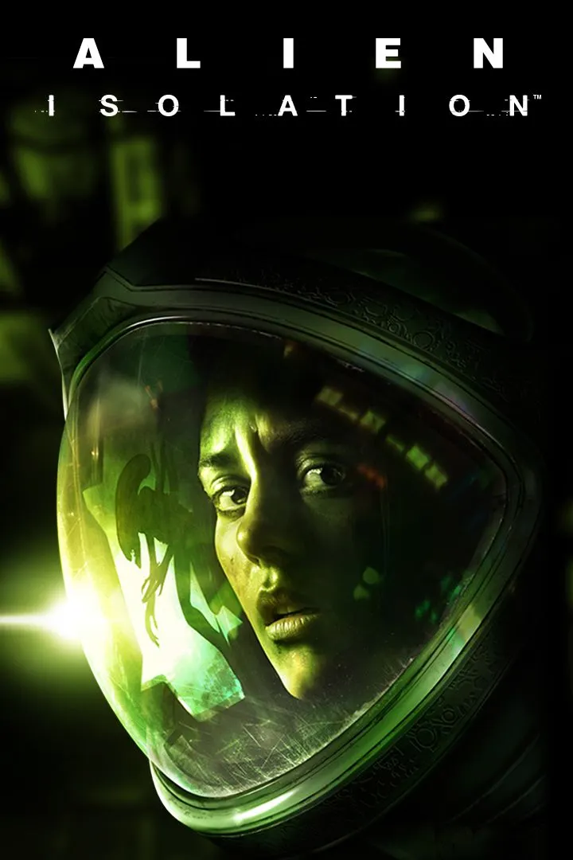
Explanation
Level 1:
Intensity: medium
Stage: Introduction
Area: Space ship
Items: Power ups , Shooting gun
Puzzles: Avoiding hits, collect coin, defeat the mini boss.
Event: Tutorial for controls and combat
Mood: Adventurous, Action
NPCs: Enemies
Plot: Escape the spaceship
Player Blurbs: "Ready to leave the Spaceship?"
NPC Blurbs: "Keep up! This is just the beginning!"
Sounds: Wind, aliens call out, engines
Growth: Learn basics
Ability Change: Control, nitro, effects

Slide 6
Galaxy shooter GG
👾 Enemy Placement
Wave 1 (Tutorial feel):
3–4 weak drone enemies approach slowly.
Player learns to shoot and dodge.
Wave 2 (Tension builds):
5–6 faster enemies come in groups.
They dodge slightly, forcing player to move.
Speed Boost power-up appears here.
Wave 3 (Challenge):
Mix of weak drones + 2 tank shielded enemies.
Triple Shoot power-up drops mid-fight → teaching player to use it effectively.
Mini-Boss Fight:
Large robotic sentinel with 2 attack phases:
Phase 1: Fires in circular bullet patterns.
Phase 2: Charges at the player, leaving gaps to dodge.
Defeating it drops a Shield Power-up, allowing survival until extraction point.

Slide 7
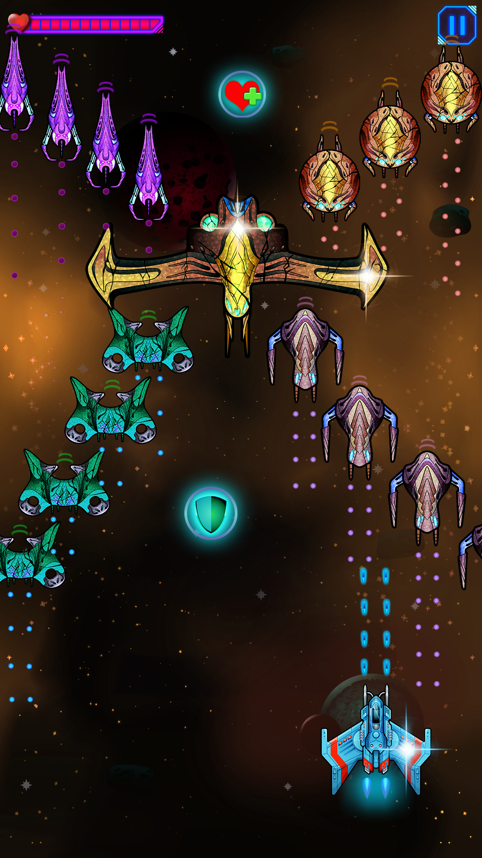
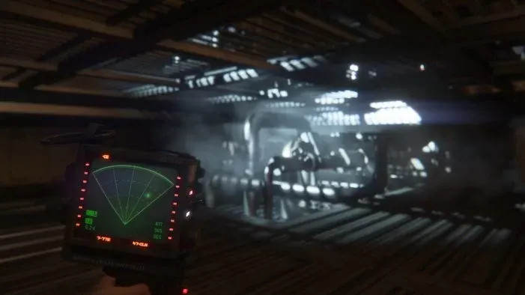
reference

Slide 8
Idea – 2D Unity Game Development Project
Title: “Mani The Hero”
Key Points:
To develop a 2D game using the Unity engine.
To implement modern Unity features and best practices.
To demonstrate a wide range of game mechanics,
from core player controls to enemy AI and a save/load system.

Slide 9
Story
Player name is Mani , a traveler trapped in a cursed pixel world. To escape, you must master new abilities and fight corrupted enemies guarding of the ruins. Your journey begins in the Forgotten Forest and ends in the Dark Fortress, where a final guardian awaits.

Slide 10
Level objective
Level 1 – Forgotten Forest 🌲
Background: A dense forest with tall pixelated trees, parallax scrolling sky, and moving platforms made of stone ruins.
Objective: Reach the end of the forest to find the hidden gate.
Abilities Learned: Run, jump, double jump, wall slide, wall jump, grapple.
Obstacles: Spikes, swinging blades, small melee enemies.
Checkpoint System: Player respawns if defeated.

Slide 11
Level objective
Level 2 – Dark Fortress 🏰
Background: A ruined fortress with broken walls, torches, and infinite parallax night sky in the background.
Objective: Defeat the fortress guardian (mini-boss).
Abilities Used: Dash, grapple, wall run, crouch slide, knockback defense.
Obstacles: Rotating fire traps, falling platforms, ranged enemies.
Boss Fight: Guardian with melee + ranged attacks and a health bar UI.
Win Condition: Collect the “Crystal of Balance” and unlock the exit gate.

Slide 12
Player Input
Unity New Input System
Player input mapping
Smooth controls for platformer

Slide 13
State Machine & Abilities
State machine update for player
Jump, Wall Jump, Wall Slide
Dash abilities
Ladder climb
Crouch & crouch run
Grapple ability
Multiple jump timing
Jump transition updates

Slide 14
Camera & Rendering
URP (Universal Render Pipeline)
Cinemachine camera setup
Pixel Perfect camera
Parallax effect & Infinite parallax

Slide 15
Player Updates
Sticky wall detection
Wall jump update
Wall slide animation
Dash ability improvements
Player abilities expansion

Slide 16
Combat & Health System
Health system & damage detection
Spikes & hazards
Knockback system & animations
Multiply knockback mechanics
Dash damage protection
Death abilities & respawn

Slide 17
UI & Feedback
Basic UI with Canvas setup
Health bar
Damage flash feedback
Death screen UI
Level change indicators

Slide 18
Environment & Mechanics
Checkpoints
Moving platforms
Death by falling
Swinging blades & rotating traps

Slide 19
Save & Progression
Save & Load system
Level transition
Senses system integration

Slide 20
Minimap & Exploration
Minimap system implementation
Player & enemy indicators

Slide 21
Weapons & Enemies
Weapon and shooting mechanics
Enemy AI with attack & death states
Smart enemy updates
Melee and ranged enemies
Boss enemy: attack patterns & health bar

Slide 22
Visual Effects & Materials
Damage material flash update
Special effects for hits

Slide 23
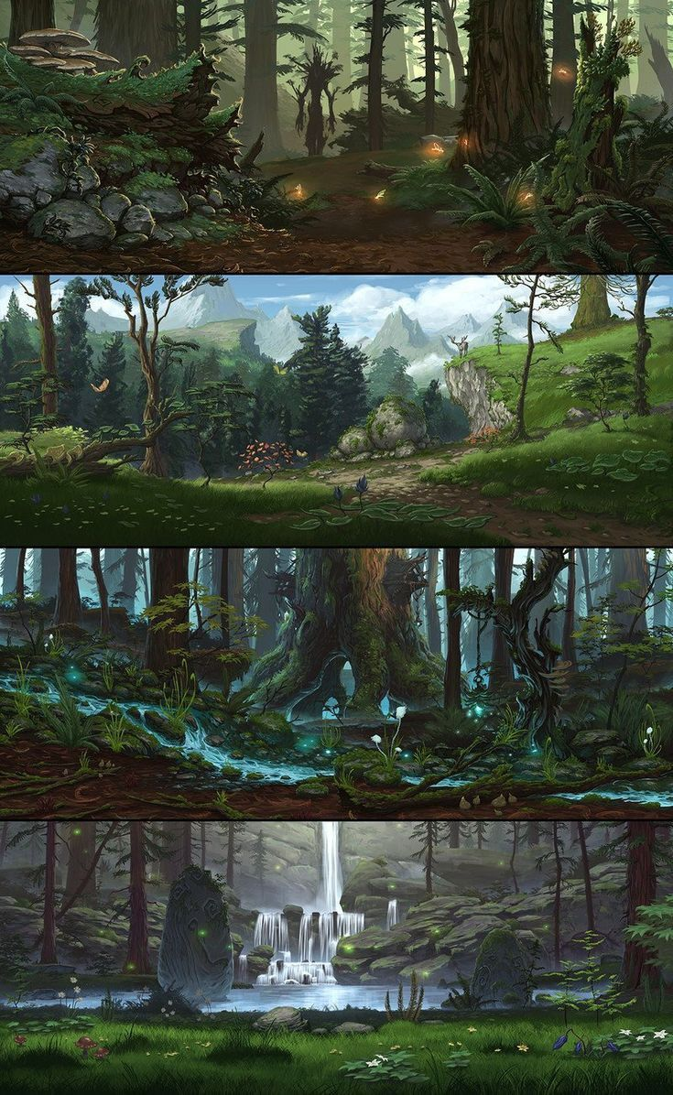
Reference for level 1

Slide 24
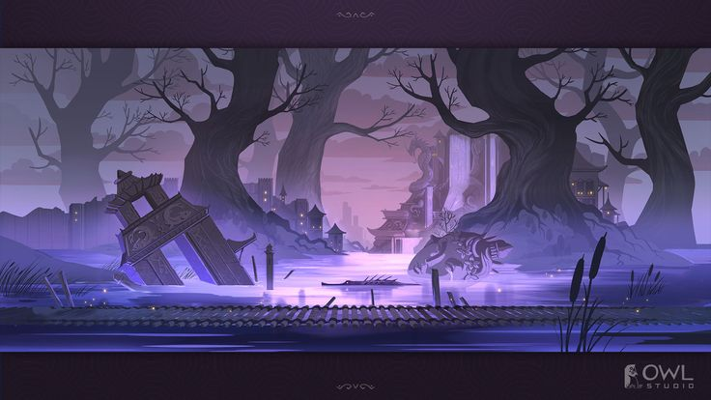
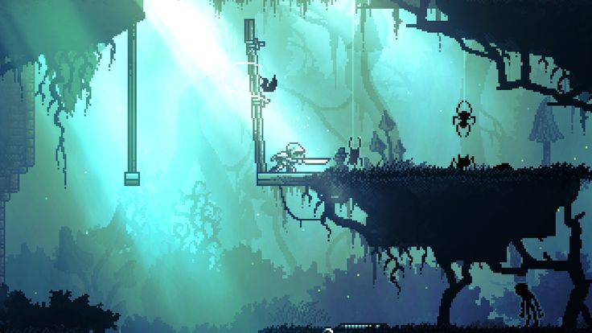
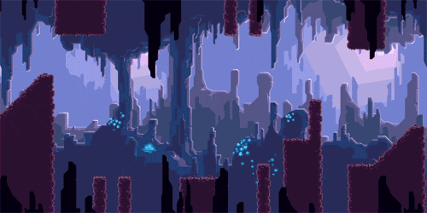
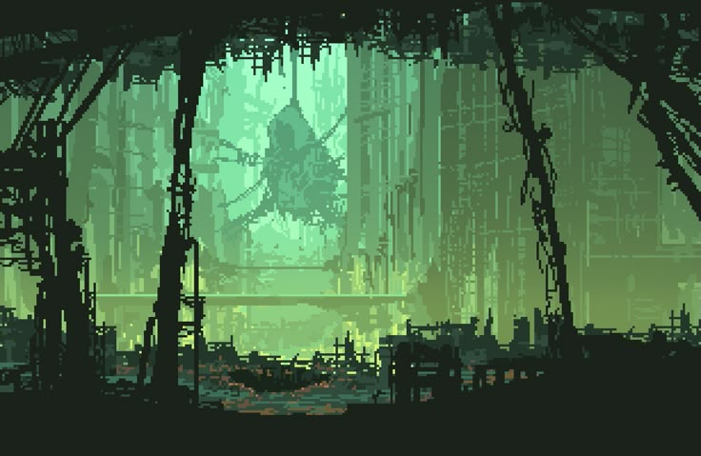
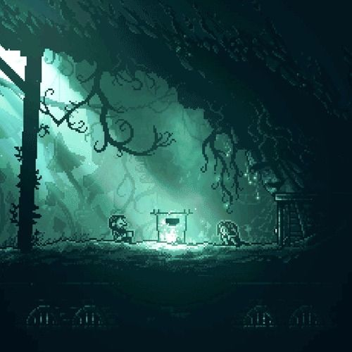
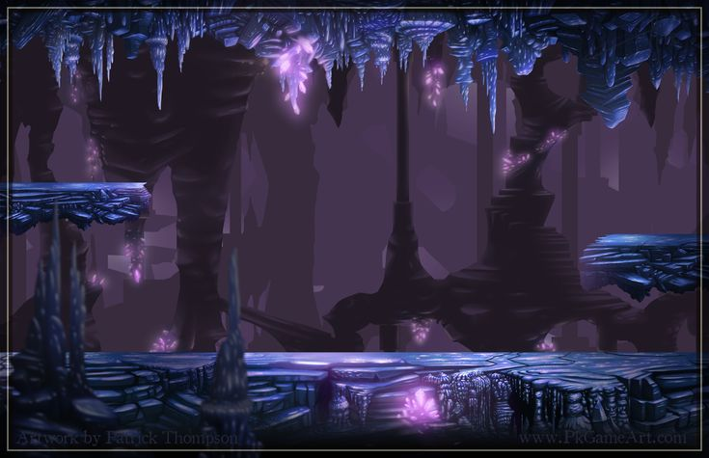
Reference for level 2

Slide 25
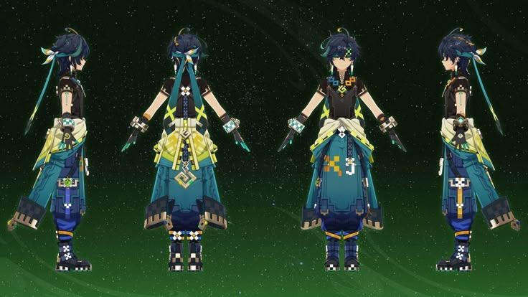
Reference for character

Slide 26
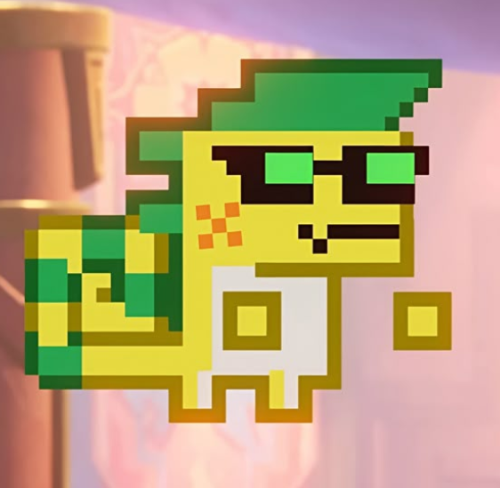
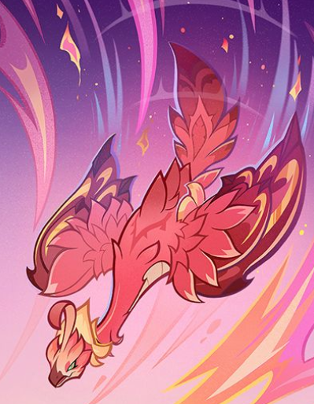
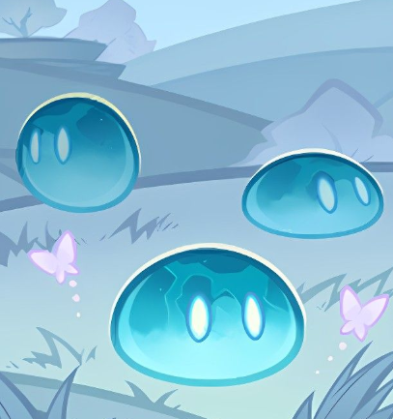

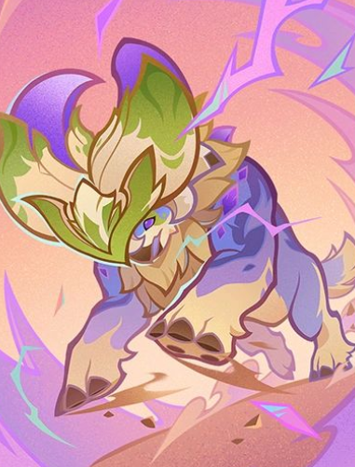
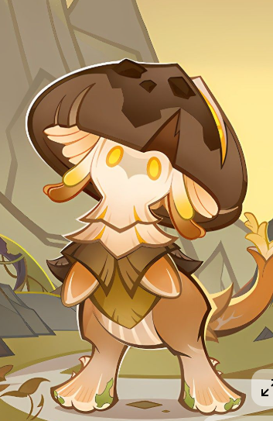
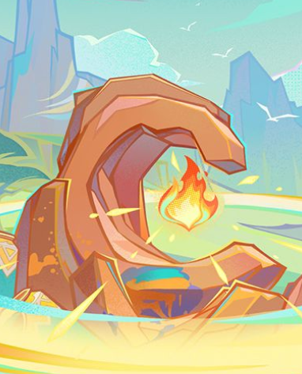
Reference for character’s buddy

Slide 27
Interaction & RPG Section
Interaction system
Scriptable objects for abilities/items
Dialogue system
RPG mechanics integration

Slide 28
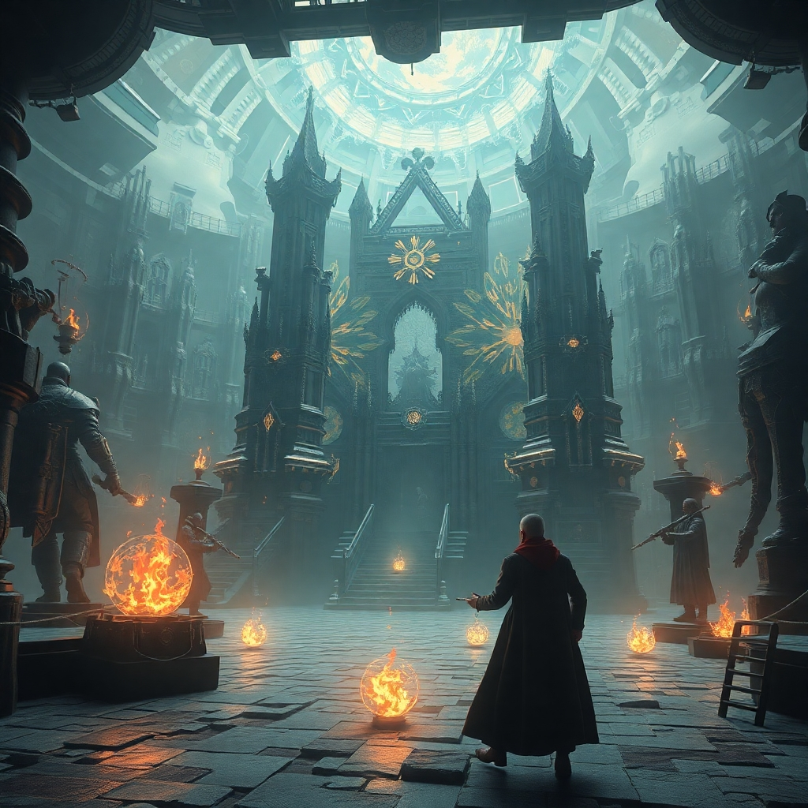
Idea 3 – Escape the Haunted Mansion (UE 5 )
In this game, players explore dark evil rooms, solve key puzzles, and uncover the mansion's secrets by navigating hidden doors and fight some AI monsters.
The goal is to escape the haunted mansion while enhancing problem-solving skills and puzzle mechanics.

Slide 29
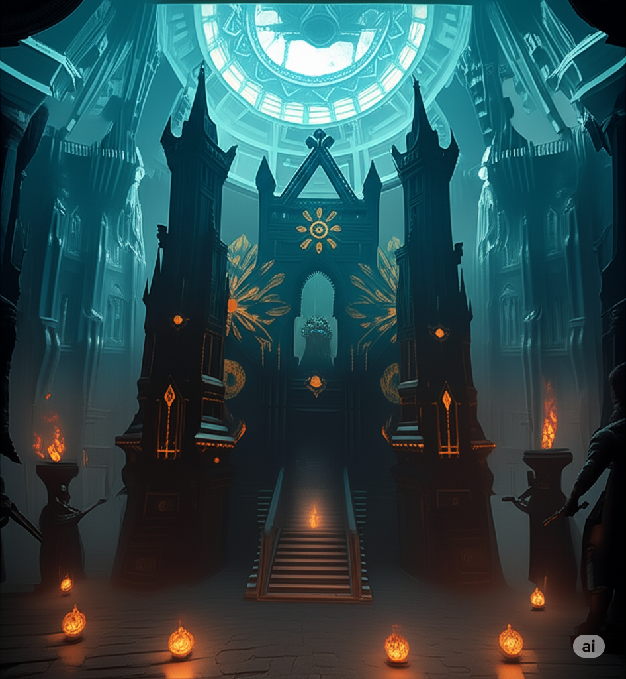
Explanation
Objective: Escape the haunted mansion.
Setting: Eerie mansion with hidden secrets.
Gameplay: Explore rooms (Entrance Hall, Library).
Solve key puzzles and unlock doors.
Interact with elevators and control panels.
Find hidden items like keys, candles, ghost detectors.
Navigate secret passages.
Puzzles:
Door Puzzle: Unlock doors in sequence.
Elevator Interaction: Use control panels.
Key Puzzle: Solve riddles to find keys.
NPCs: Ghostly guides offering cryptic hints.
Sounds: Creaking floors, whispers, eerie music.
Player Growth: Enhance problem-solving skills.
Mood: Engaged, curious, on edge.

Slide 30
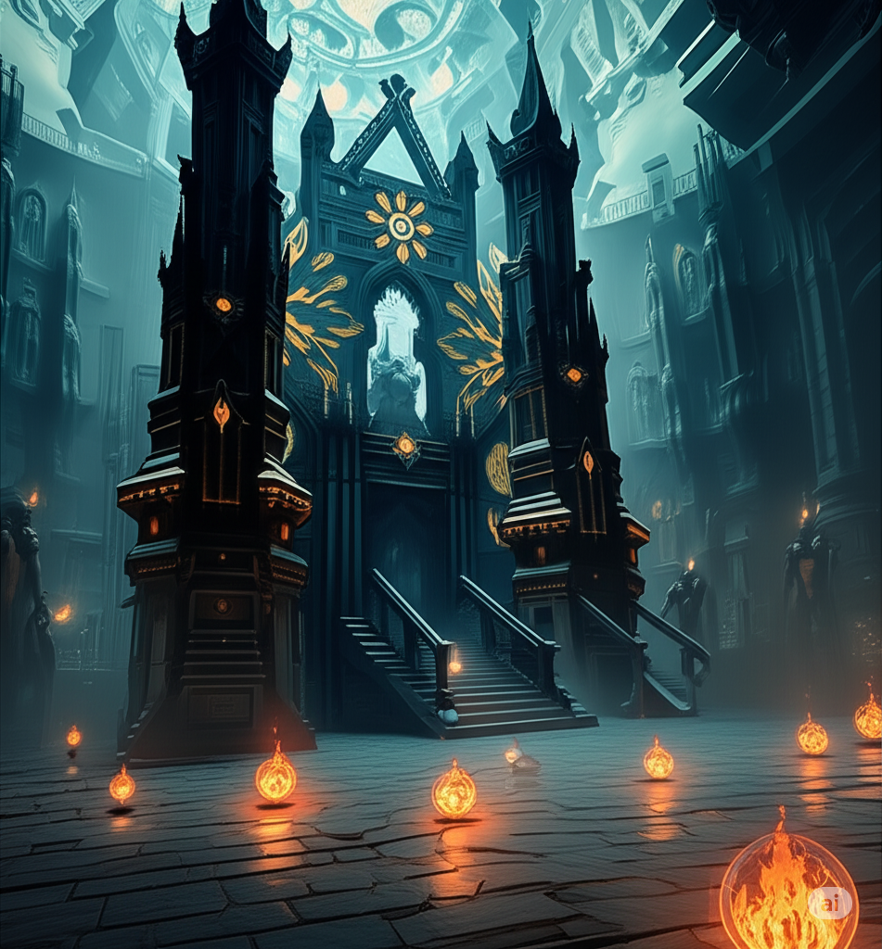
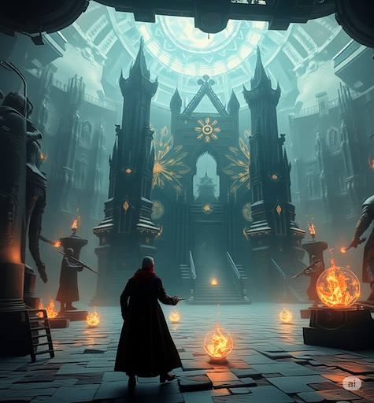
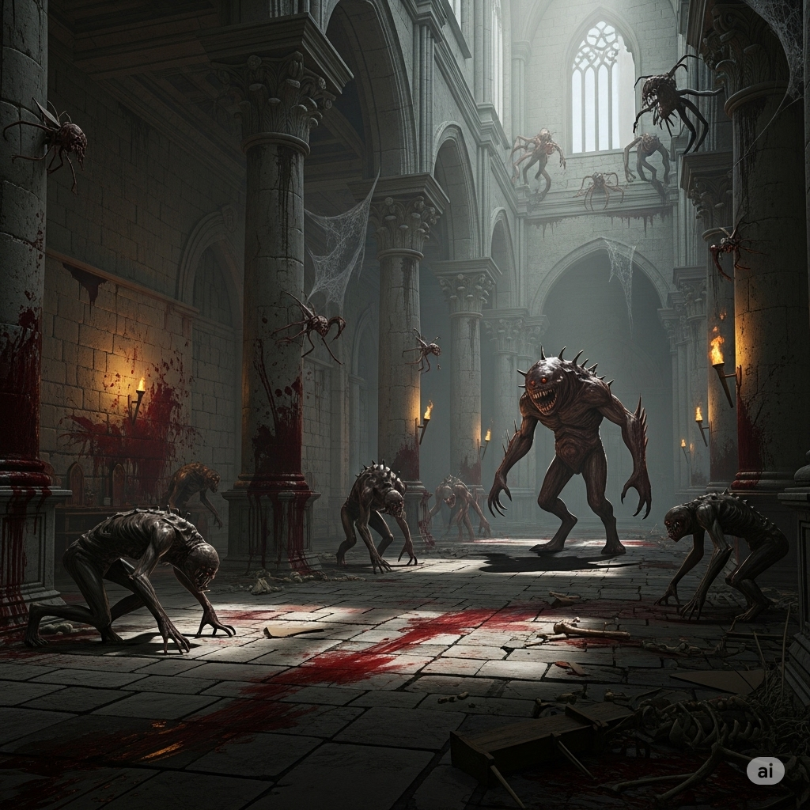
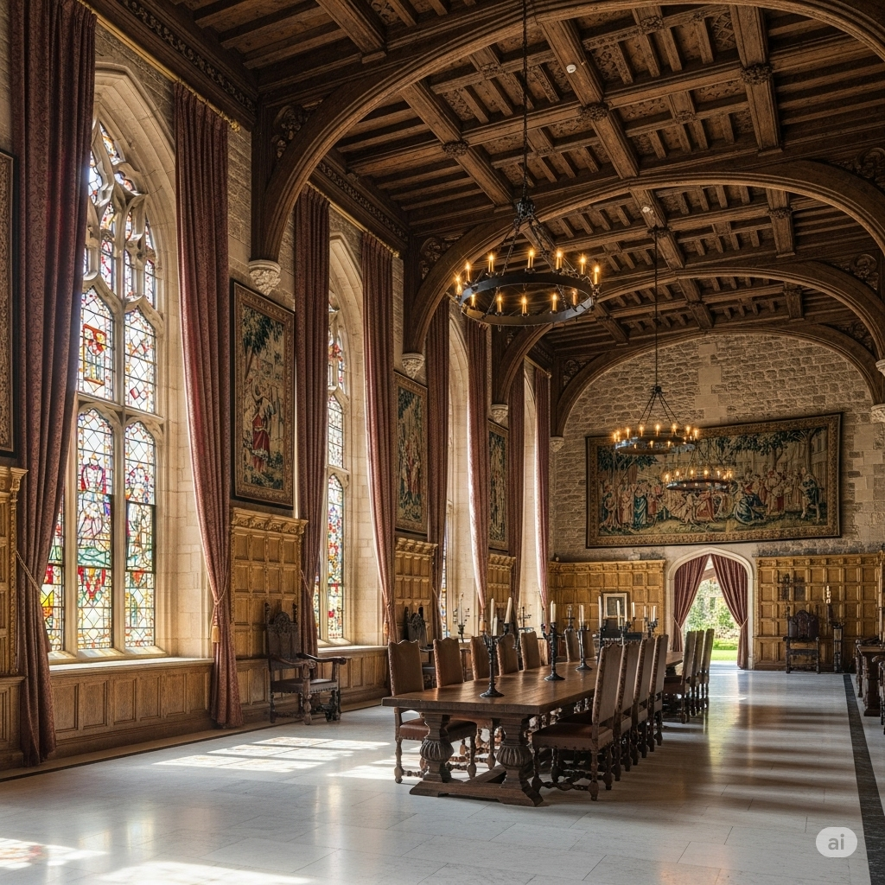
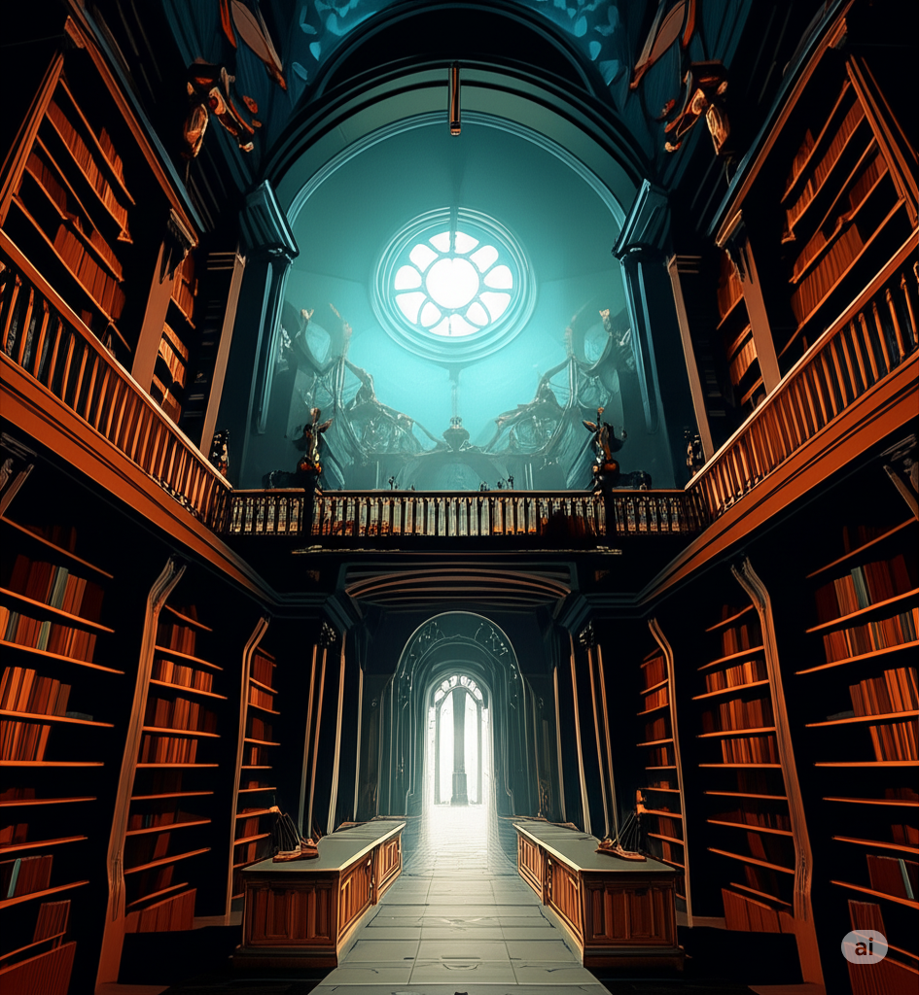
Reference

Slide 31
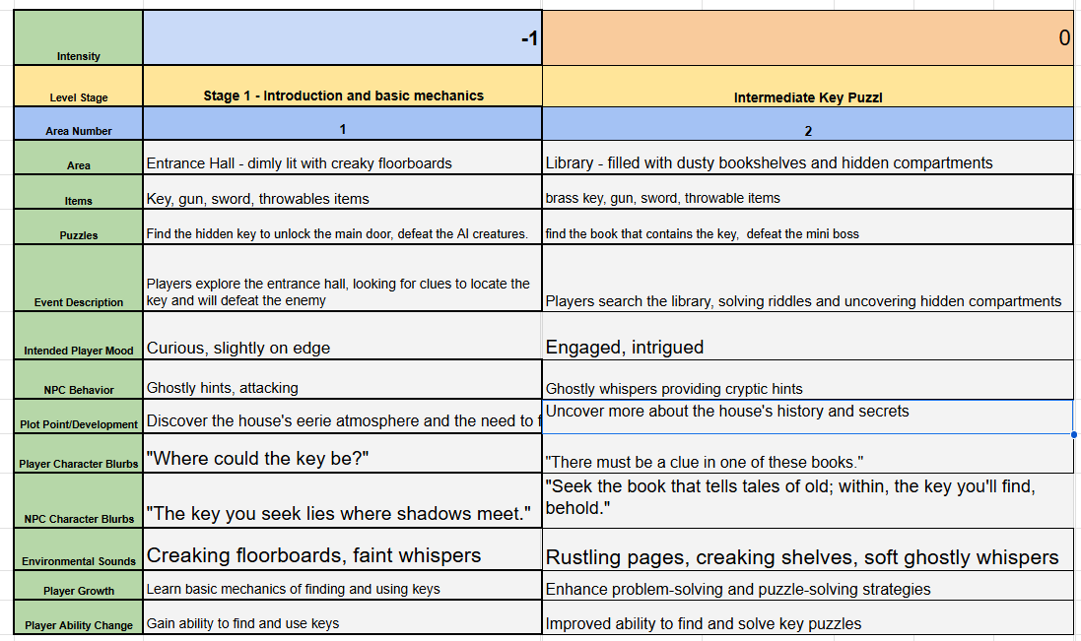
Escape the Haunted Mansion

Slide 32
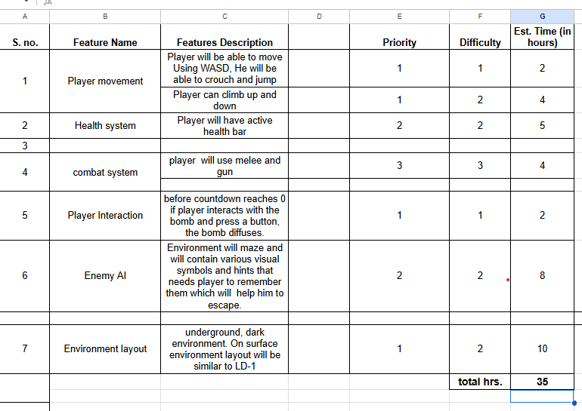
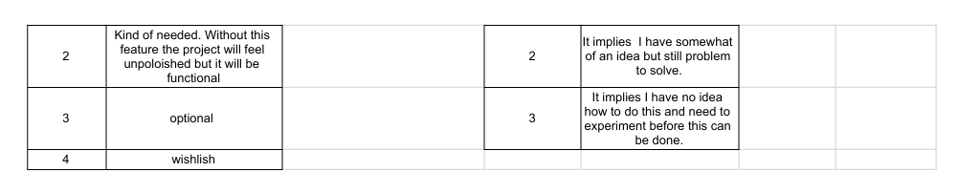
Timeline for project / week

Slide 33
Tools
Unreal engine 5
Gaea
Photoshop
Maya
zbrush

Slide 34
Thank you
J.B.MANIK
12300623
jbmaniks@gmail.com

